Slide 1
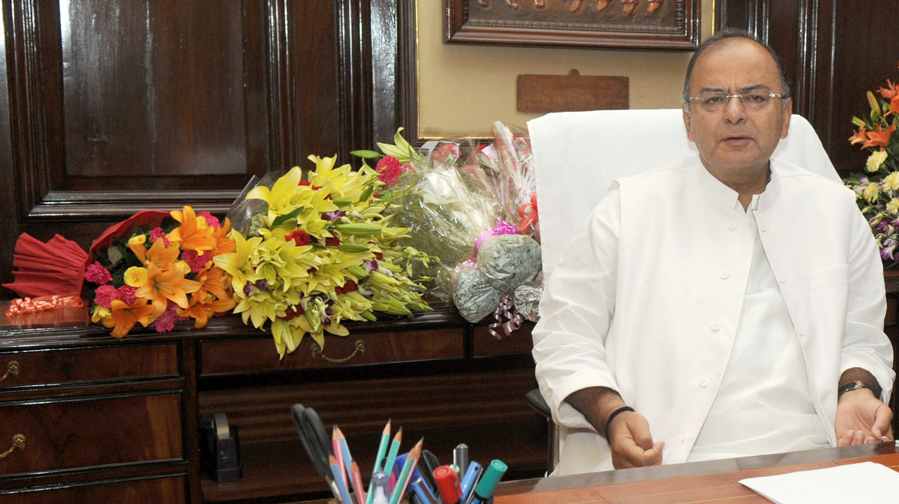

Pillar #2: Budget / Fiscal Policy
Fiscal Capacity
Taxation
Subsidies- can’t jam everything
Disinvestment
CSS Restr.
7th PC
GST, 14th FC
Self study

Slide 2
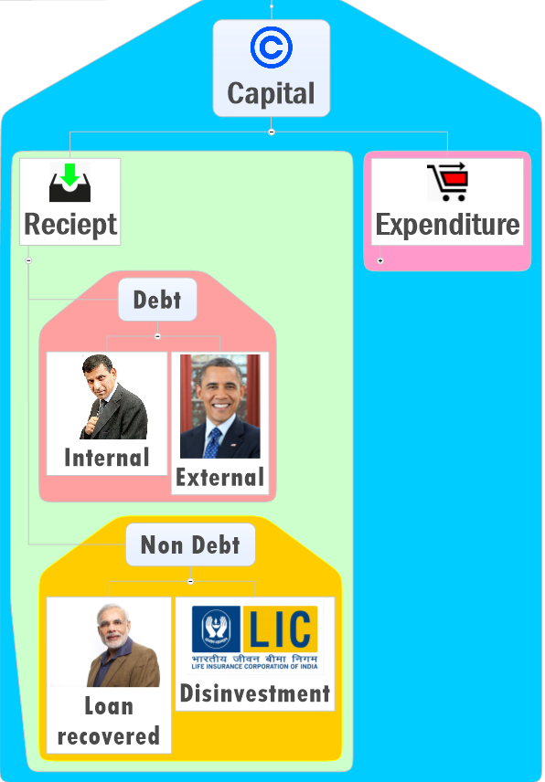
Rs. 4.9 LCr.
Mostly by long term market borrowing
98%
2%
Long term Bonds
Financial repression
Notes:
External << internal (98%)
Within internal, 84% via marketing borrowing
As such both union and state on the path of fiscal consolidation.
Focus on sustainable debt at lowest possible cost.

Slide 3



Government borrowing (IYB-2016, Page 345)
Treasury Bills / Short term
Only States: 14 days
Both through “auction”
Dated Securities / Long term
365 days or above
Sovereign Gold bond (8 years)
Union: 91, 182, 364 days
Budget-2015- launched
Budget-2016 RBI to take measures to ensure retail participation in G-Sec

Slide 4
Rs. 4.9 LCr.
Mostly by long term market borrowing
98%
2%
Rs. 56,500
Long term Bonds
Financial repression
Hardly 22,000 Cr.
▼ since 12th FC allowed states to directly borrow from market. Less union intermediation
Notes:
External << internal (98%)
Within internal, 84% via marketing borrowing
As such both union and state on the path of fiscal consolidation.
Focus on sustainable debt at lowest possible cost.

Slide 5

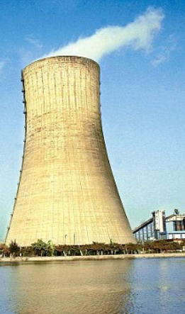
Disinvestment
Pro-Con
Timeline
Budget-2016
Methods

Slide 6
Disinvestment: ▼ shareholding in CPSE
Pro
Govt. control ▼=efficiency ▲
Lossmaking, Overstaffing
Fiscal deficit ▼
Anti
Private monopolies
▼Dividend income
Labour union oppose
Private dog-eat-dog

Slide 7
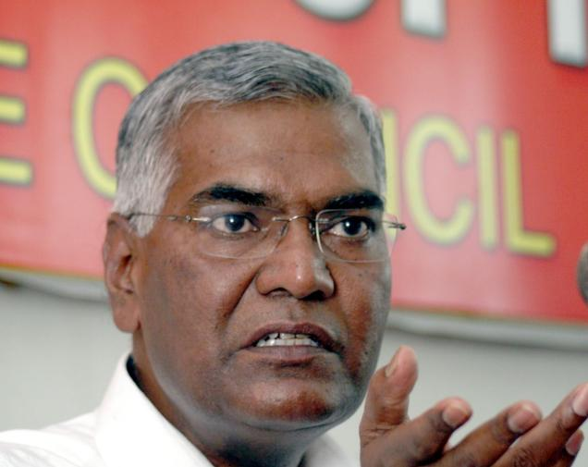
Disinvestment: A timeline
1991 industrial policy
▼ shareholding in all PSU
1998 Vajpayee
Strategic: nope
Non-strategic-phased
UPA-1 (LEFT)
Profit making: nope
Sick: revive
UPA-2 (2009-14)
All can be disinvested upto 49%
$=> NIF=>Bank recap., metro rail, nuke energy, EXIM-NABARD-RRB
Tried ETF
Railways
Defense
Atomic Energy

Slide 8


2014: ETF: Exchange Traded Fund
NFO
Min. purchase 5k
ONGC, CIL, GAIL
10 CPSE
Rs.3000 crore
Rs.10
Rs.10
Rs.20
Rs.10
Portfolio Goldman Sach
2nd CPSE-ETF in 2016 for 10 PSUs.
DIPAM (Dept. of investment and public asset management will look after this.)
BSE/NSE
Notes:
NAV fluctuates daily
1st ETF: 2014 (min. purchase Rs.5k, total 3k crore received)
2nd CPSE-ETF in 2016 for 10 PSUs. DIPAM (Dept. of investment and public asset management will look after this.)

Slide 9
3 Prevalent methods of disinvestment at present
Exchange Traded Funds (ETF)
covered
Institutional placement Programme (IPP)
offer shares only to non-retail investors
at least 25% has to be reserved for MF & insurance cos
Offer for sale (OFS)
@stock exchange: Both retail and non-retail investors;
20% quota for retail investors (upto Rs.2 lakh bidding)
Latest
NHPC: ~11% shares sold, 2.7kcr

Slide 10
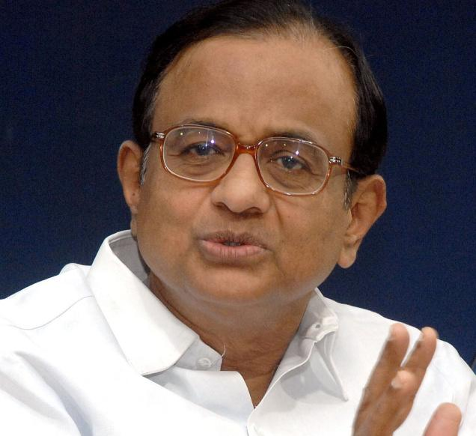
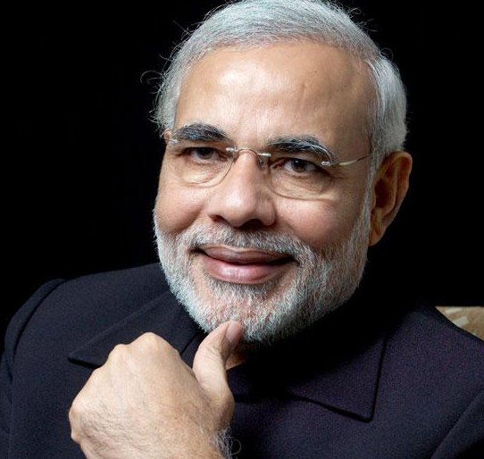
Disinvestment: A timeline
UPA-2 (2009-14)
All can be disinvested upto 49%
$=> NIF=>Bank recap., metro rail, nuke energy, EXIM-NABARD-RRB
Tried ETF
NDA (2014-)
5 sick: revive- HMT tools etc.
Minor stake sales
6 bogus shutdown: HMT watches, Hindustan Photofilm
ETF-2nd Round in 2016

Slide 11
Disinvestment
Pro-Con
Timeline
Budget-2016
Methods

Slide 12
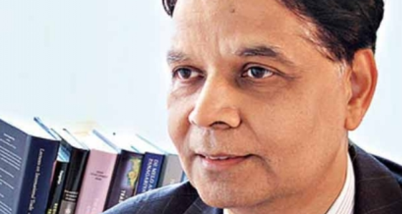
Disinvestment target (Cr. Rupees)
36,000 Cr.
Minority stake sales
20,500 cr.
Strategic sale of sick units
Will goto Natl. investment fund (Public account)
Adverse market conditions, postponed
=selling away 50% />
I’ll submit blueprint ☺
Notes:
36k from minority stake sales)
20,500 from strategic sale.
Govt ordered cash rich PSUs to either give higher dividend, or start share buyback.
Share buyback= Govt gets money and later on per share earning also increase.

Slide 13
Find correct statement
Yearbook
“Divestment” subject falls under the domain of Ministry of heavy industries & public enterprises.
In India, “Strategic disinvestment” means divesting from CPSE associated with atomic energy, defense and railways.
Both Correct
None correct
Right answer

Slide 14
Which Department looks after disinvestment?
fin.min
Economic Affairs
Expenditure
Revenue
Financial services
Disinvestment Investment & Public Asset Management
Budget=>
Survey=>CSO,CEA,Finsec,FM
CGA-ICAS via UPSC-CSE
7th PC report implementation
Divest individual assets of PSU such as land, mfg.unit etc. to release $$ for new projects, Restructuring, capitalization
Renamed in Budget 2016

Slide 15
Rs. 4.9 LCr.
Pro-Con
Timeline
Budget-2016
Methods
98%
2%
Rs.22,000 Cr.
Rs.56,500 Cr.

Slide 16
Pillar #2: Budget / Fiscal Policy
Fiscal Capacity
Taxation
Subsidies- can’t jam everything
Disinvestment
CSS Restr.
7th PC
GST, 14th FC
Self study

Slide 17
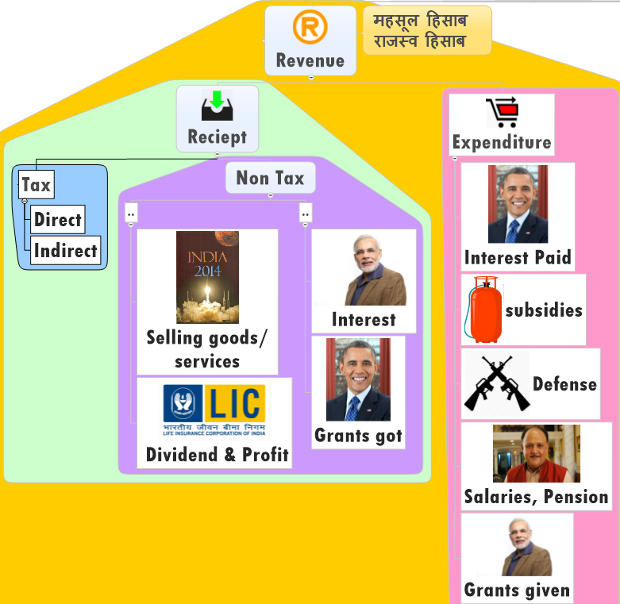
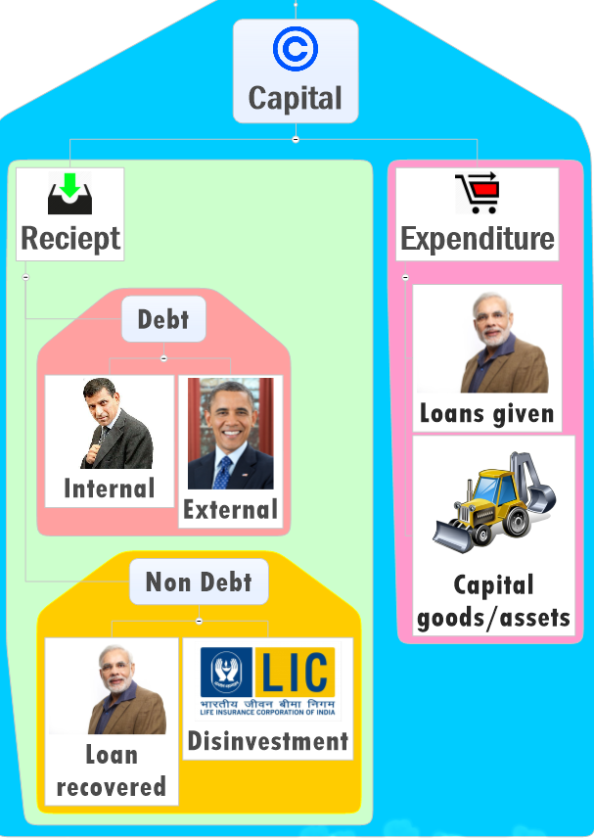

Slide 18


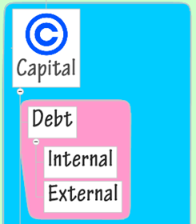
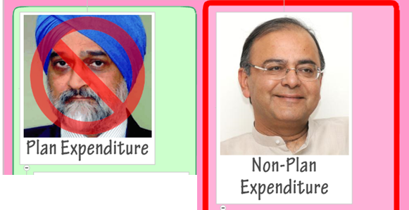
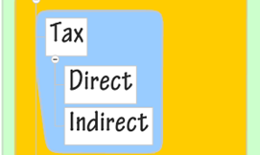
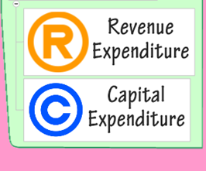
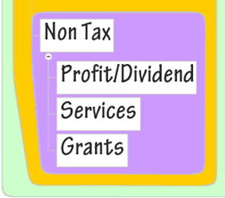
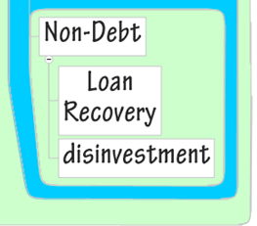

Slide 19
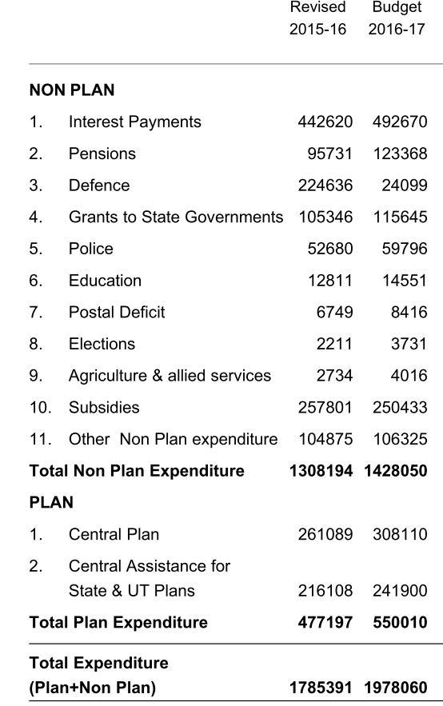
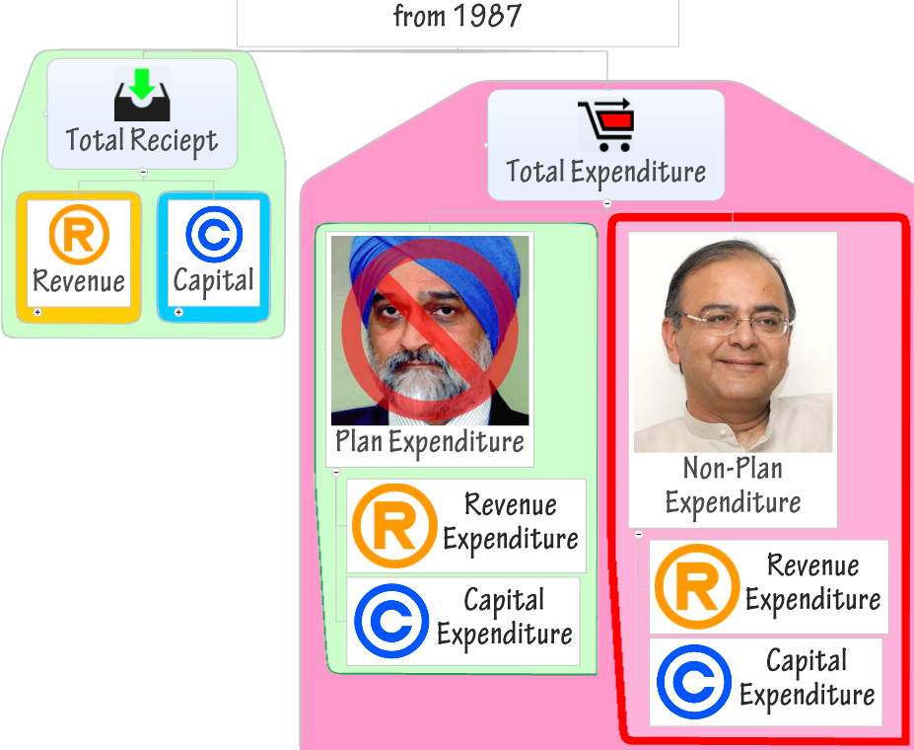
Why ▲?
Why ▼?
Why ▲?
Notes:
Budget 2014: CSS down to 66
FFC: 32% => 42%
Hence Central plan Expenditure decreased.
CSS funds are released as central assistance to state plans= greater autonomy, authority and responsibility to the states in implementation of schemes.

Slide 20
Doing away with Plan-Non-plan
Plan Expenditure = good; non-plan=bad
Skewed allocation by this mindset
2016: 12th FYP will end;
Budget-2017: Government will do away with plan vs. non-plan
Instead focus to Revenue vs. Capital classification
States to follow the same
Each scheme to have sunset date & outcome review

Slide 21

ML2/P1
GS Mains Paper2- Govt Policy: Issues in design & implementation

Slide 22
Multiple schemes + Bureaucratic machinery Empire within empires=> duplication of man, material and money resources
UPA
147 CSS
2013: UPA
Reduced to 66
2014: NDA
Modi added 6
=72
2015: NDA
Niti Ayog Shivraj Panel
Reduce to 27 (Nov)

Slide 23
CSS restructured- 27
8 North Eastern
3 Himalayan States
Type
Core of the core
Core
Schemes
06
Special
Optional
18
03
General
Existing
Existing
90-10
60-40
80-20
50-50

Slide 24
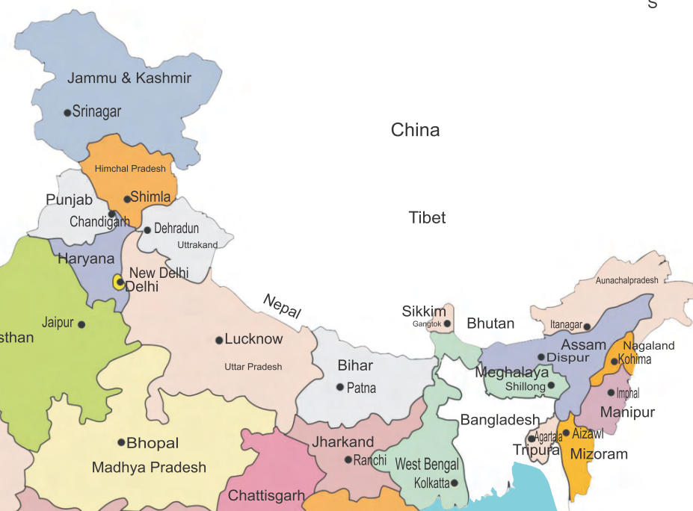
Special category states? 8+3=11
8 NE
Arunachal Pradesh
Assam
Manipur
Meghalaya
Mizoram
Nagaland
Sikkim
Tripura
3 Himalayan States
Uttarakhand
Himachal Pradesh
Jammu and Kashmir
HW: Map based MCQs

Slide 25

Core of the Core
06
MNREGA
Nat. Social Assistant Program
Umbrella Scheme for SC
Umbrella Scheme for ST
Umbrella Scheme for OBC
Umbrella Scheme for Minorities

Slide 26
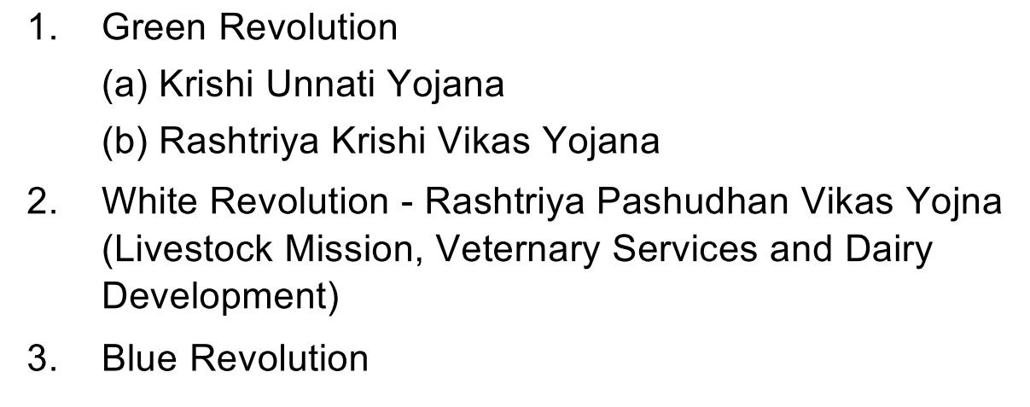
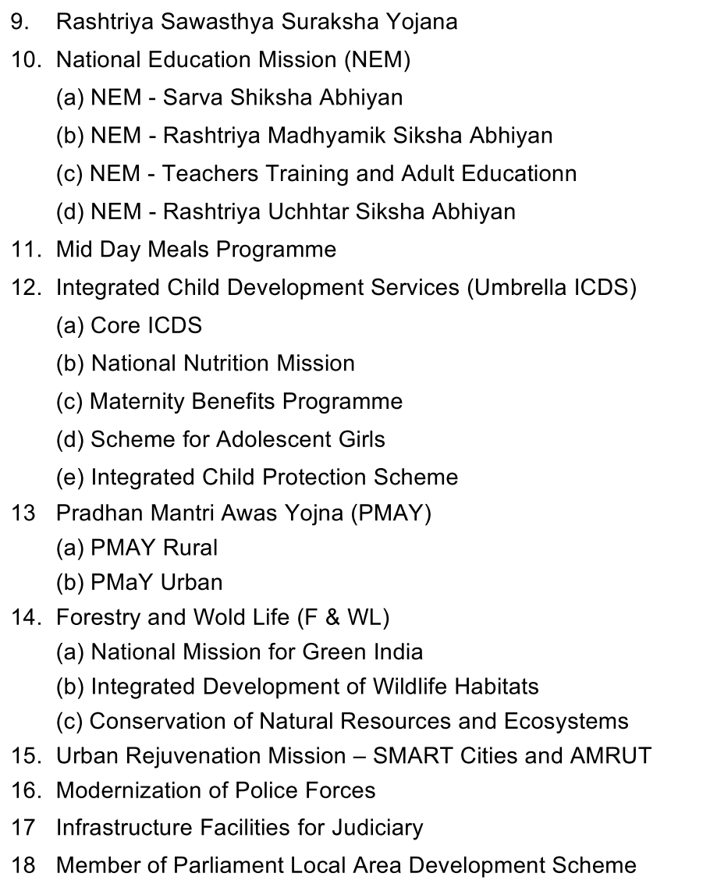
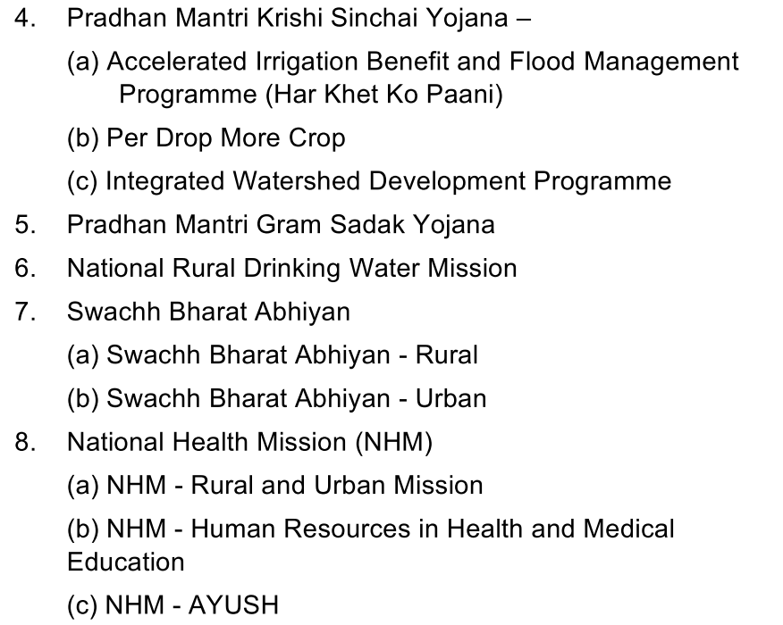

18 Core Schemes
funding
60:40
90:10

Slide 27
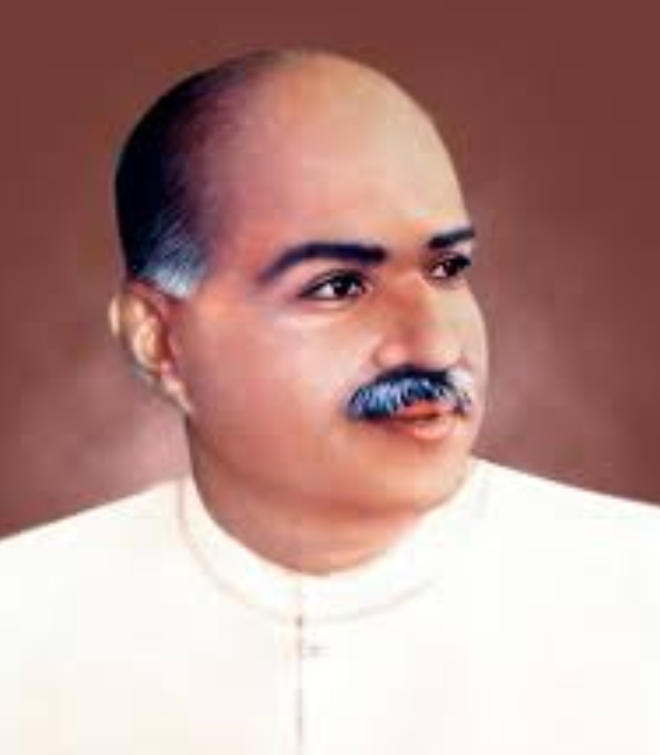

Optional Schemes
03
Border Area Development Programme
National River Conservation Plan
Shyama Prasad Mukherjee RURBAN Mission

Slide 28
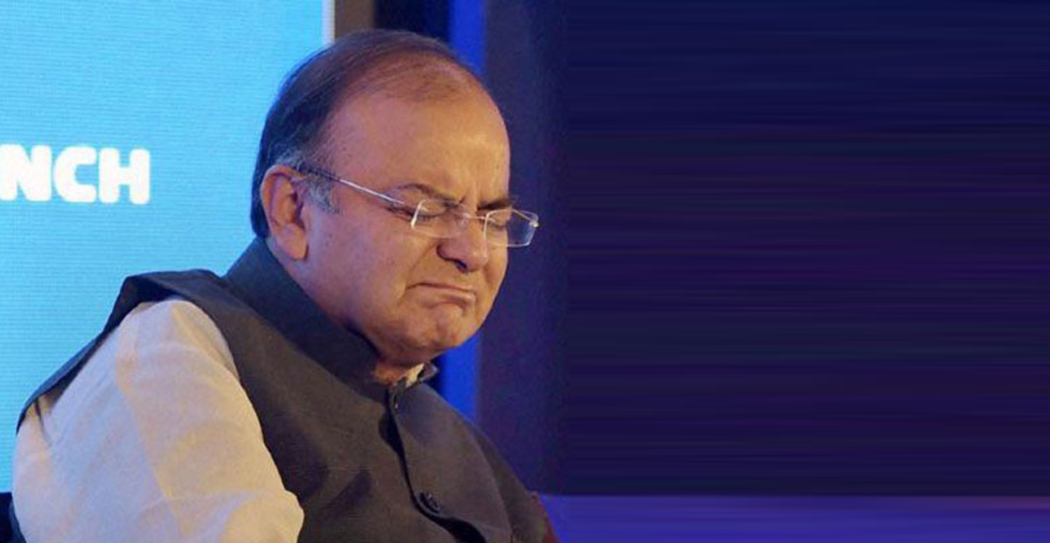
Fiscal Deficit
Calculation
Why Bad?
How to achieve?
Target

Slide 29
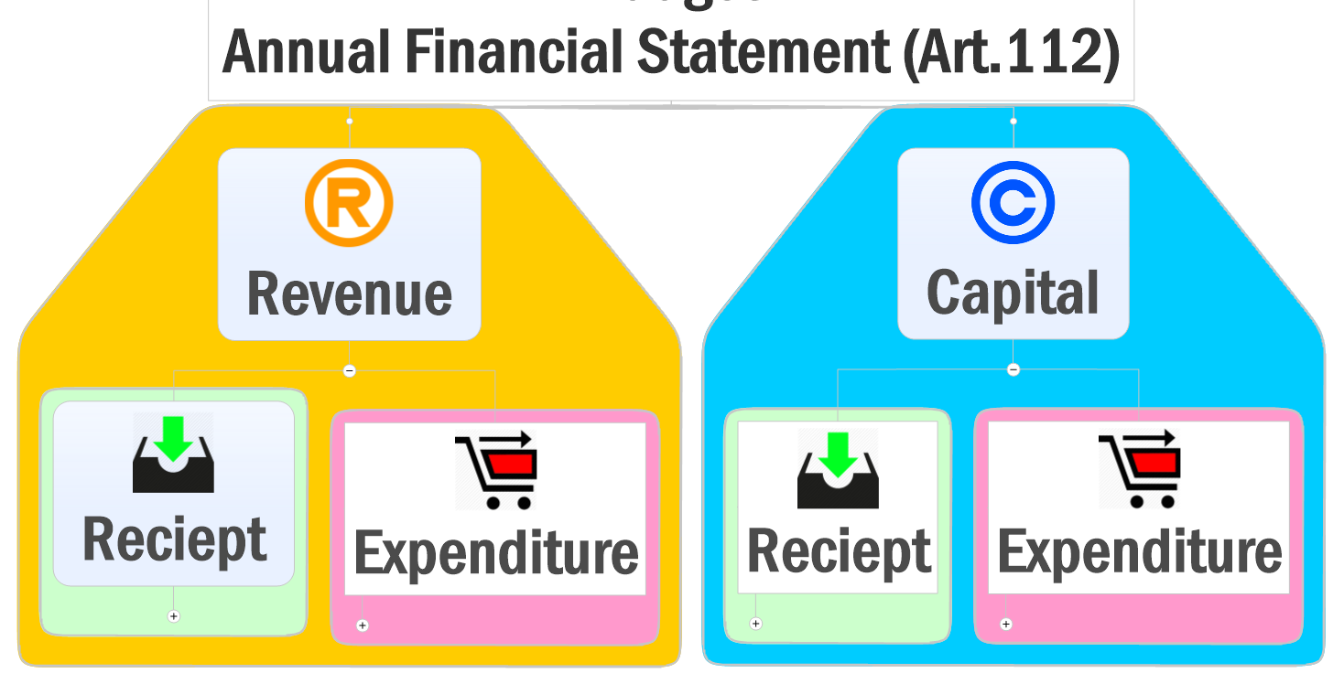
Budget 2016: numbers not exact, just for illustration
+13.7 Lcr.
-17.3 Lcr.
+6 Lcr.
-2.4 Lcr.

Slide 30
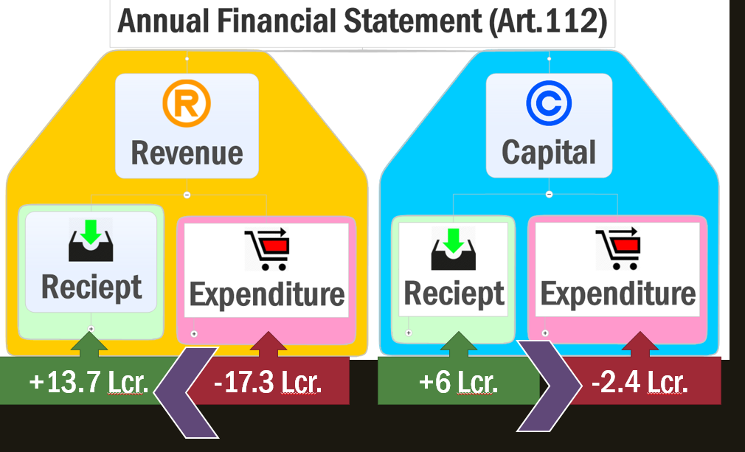
Budget 2016: numbers not exact, just for illustration
Total Expenditure
-19.7
Total Receipt
+19.7
Budget Deficit
0

Slide 31
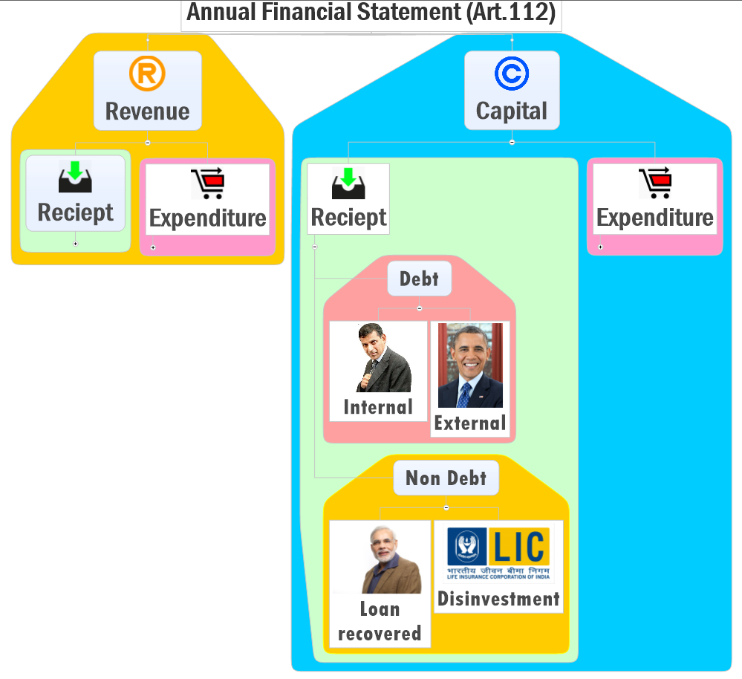
Budget 2016: numbers not exact, just for illustration
+13.7 Lcr.
-17.3 Lcr.
-2.4 Lcr.
Market borrowing
+56,500
Add all these numbers
~<6 lakh crore.
+10,600

Slide 32
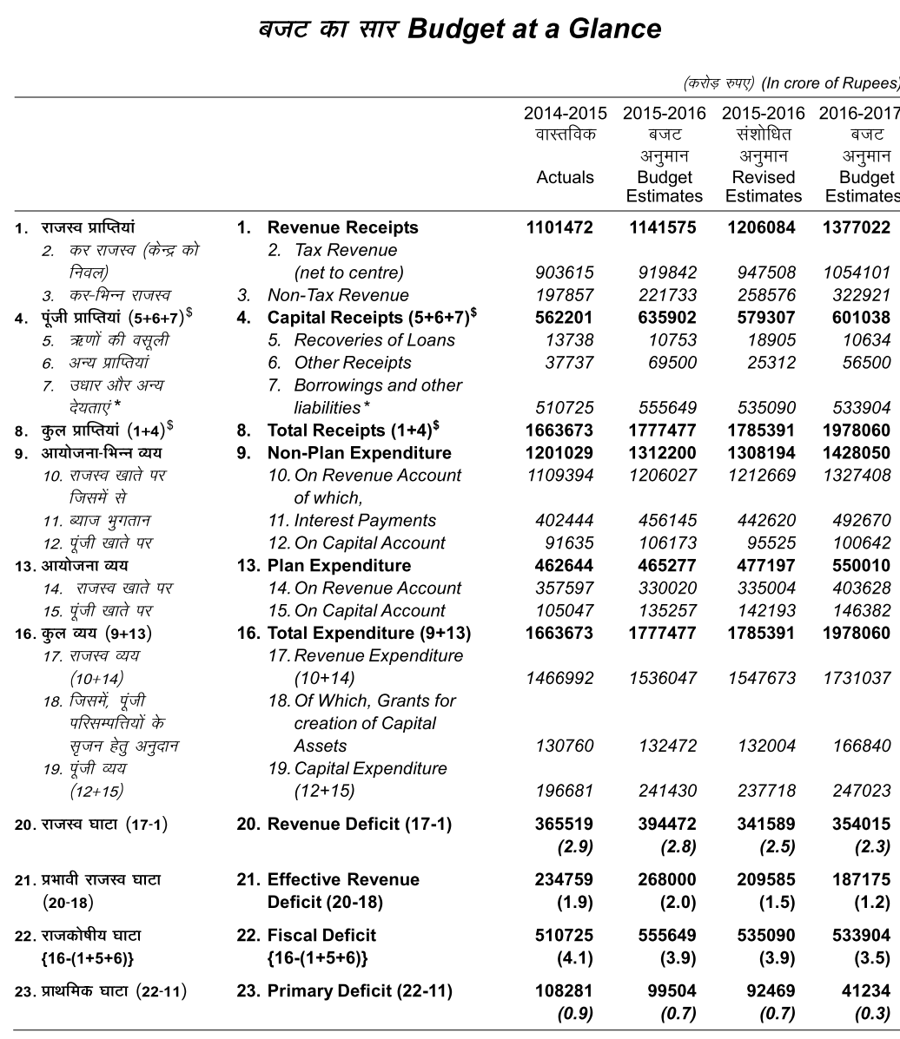
Manmohan
Mentioned in Budget 1993 documents
Primary
Deficit
Interest
Payments
Fiscal
Deficit
Budget
Deficit
+ Market
Borrowing

Slide 33
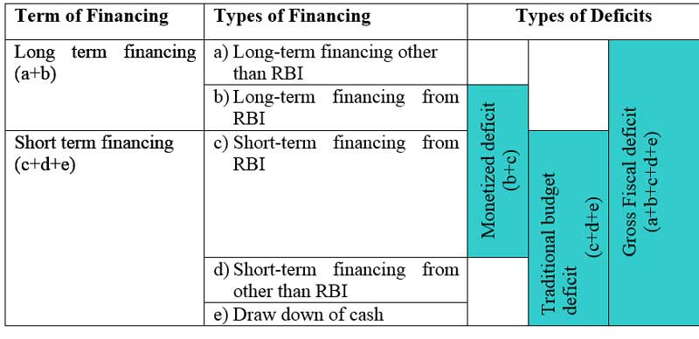

Homework: Read chapter
Financial Administration

Slide 34
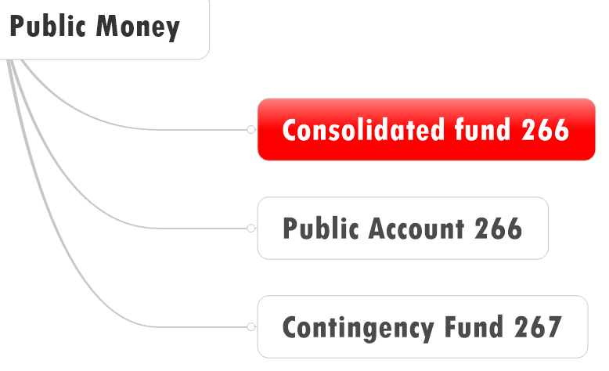
Debt
Total Liabilities
Public Debt
Other liabilities
NSSF, PLI

Slide 35



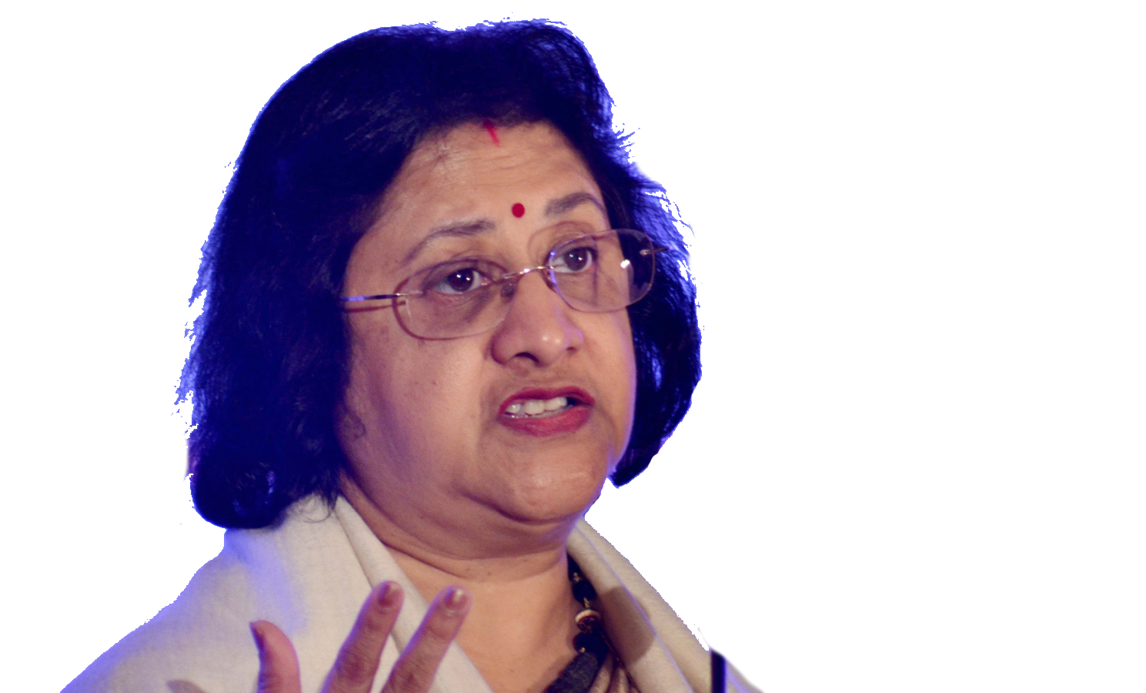
Why High fiscal deficit is bad?
Sovereign Bond rating ▼
Market borrowing ▲
RBI ?
PSB>SLR
Foreigners
Higher return?
BoP crisis?
Financial repression
Monetizing deficit
DDSLLY/RGSLLY
FDI relax vs employment
Residents
Taxation, user fees
“EXIT”/ “Free-riders”
Gold/real Estate
Inflation
Credit growth

Slide 36
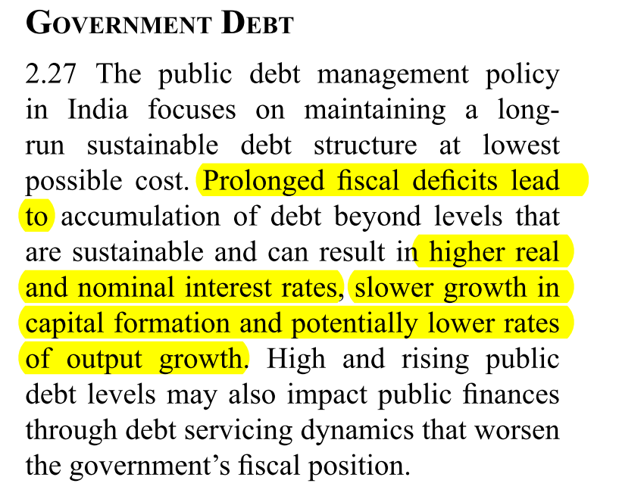
Prolonged fiscal deficit results in….
Survey 2015, v1c2, Page 45
Higher real and nominal interest rates
Slower growth in capital formation
Lower rates of output growth
All of above

Slide 37
FRBM Act 2003- both union and states
Of GDP | Deadline
0% Revenue deficit | 31/3/2008
3% fiscal deficit | 31/3/2009

Slide 38
All Deficit targets
Budget deficit
+ Market borrowing
Revenue Receipt
- Revenue Expdr.
Revenue Deficit
- Grants in capital assets

Slide 39
Fiscal Deficit: GSM3- Resources mobilization
Calculation
Why Bad?
How to achieve?
Target
Expense ▼
Income ▲
▲ Fiscal Capacity
▼Revenue Expenditure
Fiscal consolidation

Slide 40
To control deficit: ▲Income; fiscal capacity
Did not raise IT slabs
Higher surcharge on super-rich, TCS on luxury cars & Cash payment
Phase out deduction
▲ Startup & MFG. activity
Litigation ▼; easy of paying taxes ▲
Intro: GST, GAAR, PoEM
Notes:
VIII. Fiscal Discipline
received conflicting suggestions about the FRBM roadmap. Different schools of thought have argued either in favour of fiscal consolidation and stability or for a less aggressive
consolidation and for boosting growth.
Consequently, the fiscal deficit in RE 2015-16 and BE 2016-17 have been retained at 3.9% and 3.5% of GDP respectively.
While doing so, I have ensured that the development agenda has not been compromised.

Slide 41
To control deficit: Reduce Expenditure
CSS restructure
Sunset dates for schemes; NITI=>3rd party review
No LPG-Pahal >10L; subsidies ▼
Panel to restructure Manpower
Tune up user-fees
Notes:
Multiple schemes with similar targets are put under an umbrella scheme
No more plan-non-plan distinction from 2017 budget
Niti Ayog=>periodic 3rd party evaluation, de-duplication, focus on outcomes.
Similar schemes with one dept only.
Non-tax revenue resources such as user fees and spectrum charges.
VIII. Fiscal Discipline
received conflicting suggestions about the FRBM roadmap. Different schools of thought have argued either in favour of fiscal consolidation and stability or for a less aggressive
consolidation and for boosting growth.
Consequently, the fiscal deficit in RE 2015-16 and BE 2016-17 have been retained at 3.9% and 3.5% of GDP respectively.
While doing so, I have ensured that the development agenda has not been compromised.

Slide 42
FRBM Reform
FRBM should have range rather fixed target
Will policy space in dynamic situation of global economy
Expert panel to review- union, state, academicians representatives.
Budget 2016

Slide 43
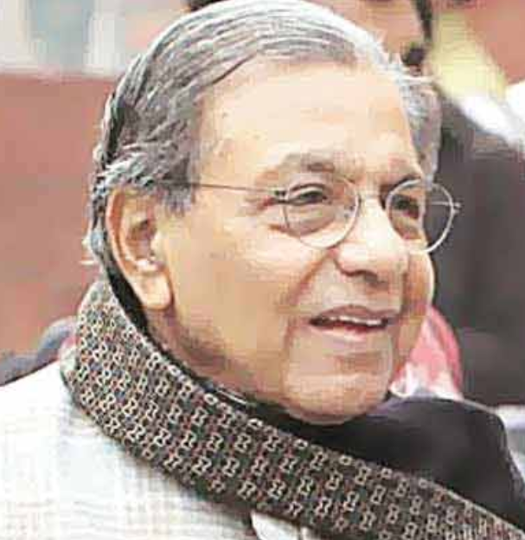
What’s new?
FRBM Reform
5 member FRBM review Committee
Former Revenue Secretary and Rajya Sabha MP N.K. Singh
Urjit Patel, Dy.Gov, RBI
Other 3- not ‘VIP’ enough for exam
Deadline: 31st October 2016:=Hence important for both PRE+MAINs

Slide 44
Pillar #2: Budget / Fiscal Policy
Fiscal Capacity
Taxation
Subsidies- can’t jam everything
Disinvestment
CSS Restr.
7th PC
GST, 14th FC
Self study

Slide 45

Theory +Economic Survey Vol.2 + Vol.1 + Budget 2016
1.Banking Finance
6.HRD
2.Budget-Fiscal Policy
3.BoP
4.Sectors of Economy
5.Infra
V2C2-Pub.Fin; V1C3-JAM
V2C3-Monetary mgmt+FI
V2C4-External sector
V2C5-Price,Agri.; V2C6,7
V2C8-Paris Summit, Energy
V2C9-Social infra.
V1C4-Agri ; V1C9-Fertilizer
V1C5-mother-child
V1C6-bounties; V1C7-Fiscal Cap
V1C8-PTA
V1C2-Chakravy; V1C10-Labour
V1C11-Powering 1 India
B1. Financial Sector Reforms
B2. Fiscal Discipline
B3. Tax Reforms; B4. Ease of
B5. Agro: 2x farmer income
B6. Rural infra-employment
B7. Infrastructure
B8. Social Sector & healthcare
B9. Education, Skills, Jobs
V2C1- Chakravyuh challenge
V1C1- Twin Balancesheet
+Survey Ch.1s Spread throughout; SDG-Goal esp. @#4,5,6; HDI Report@6

Slide 46
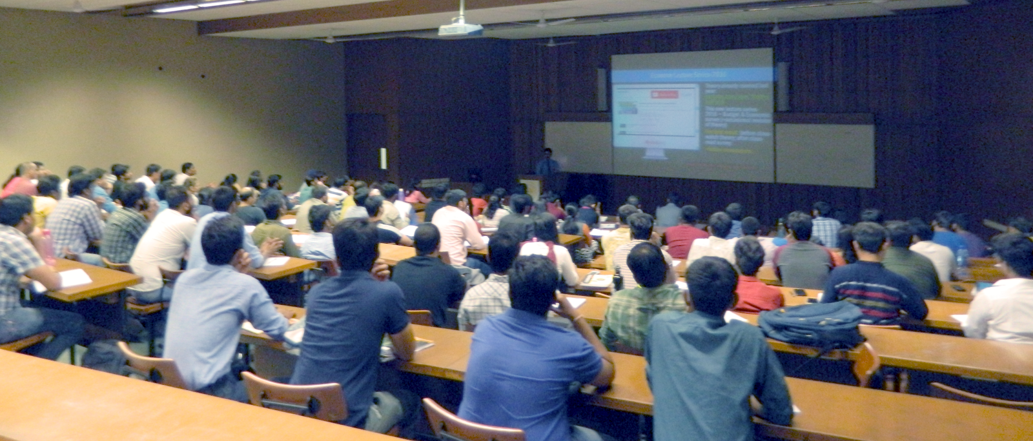
For best results..
After Today’s Lecture
Self study After Today’s Lecture
V2C2-Pub.Fin; V1C3-JAM
V1C6-bounties; V1C7-Fiscal Cap
Laxmikanth PubAd- ch. on Fin Administration
IYB Ch. 13 Finance
Before next lecture
Go through past theory videos:
L2 finance and L3-BoP
youtube.com/user/TheMrunalPatel
+ Daily English newspaper: Hindu (1st Preference) OR Indian express

